Slide 1




Introduction to Data Visualization: Theory and practice using R
Juliana Assis
Senior Data Scientist
jasge@dtu.dk

Slide 2
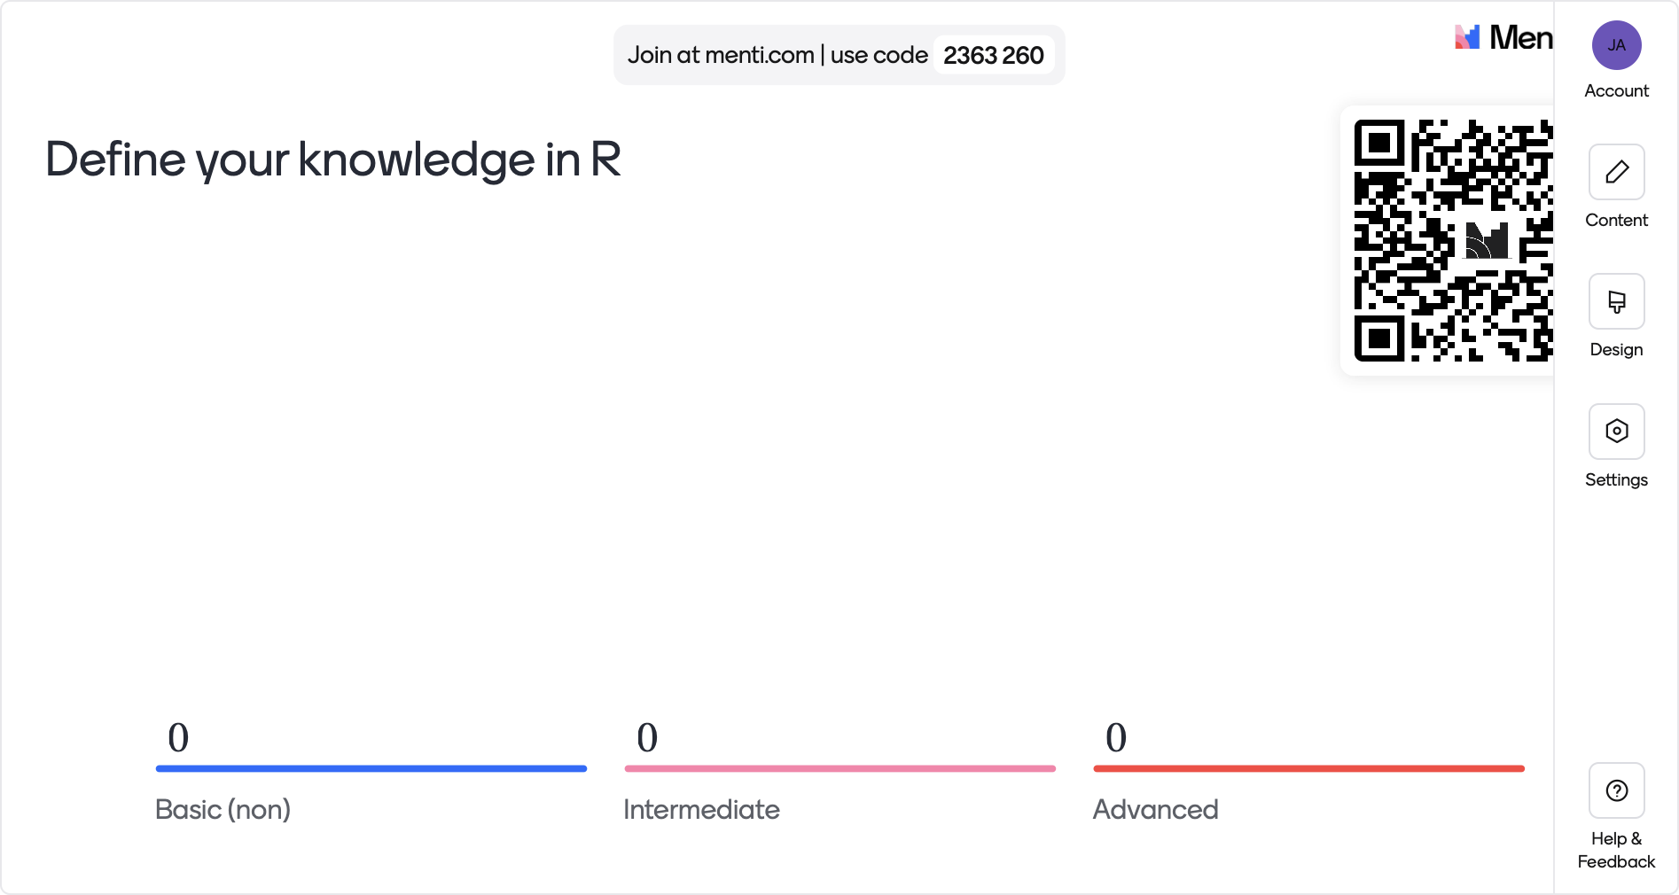

Slide 3
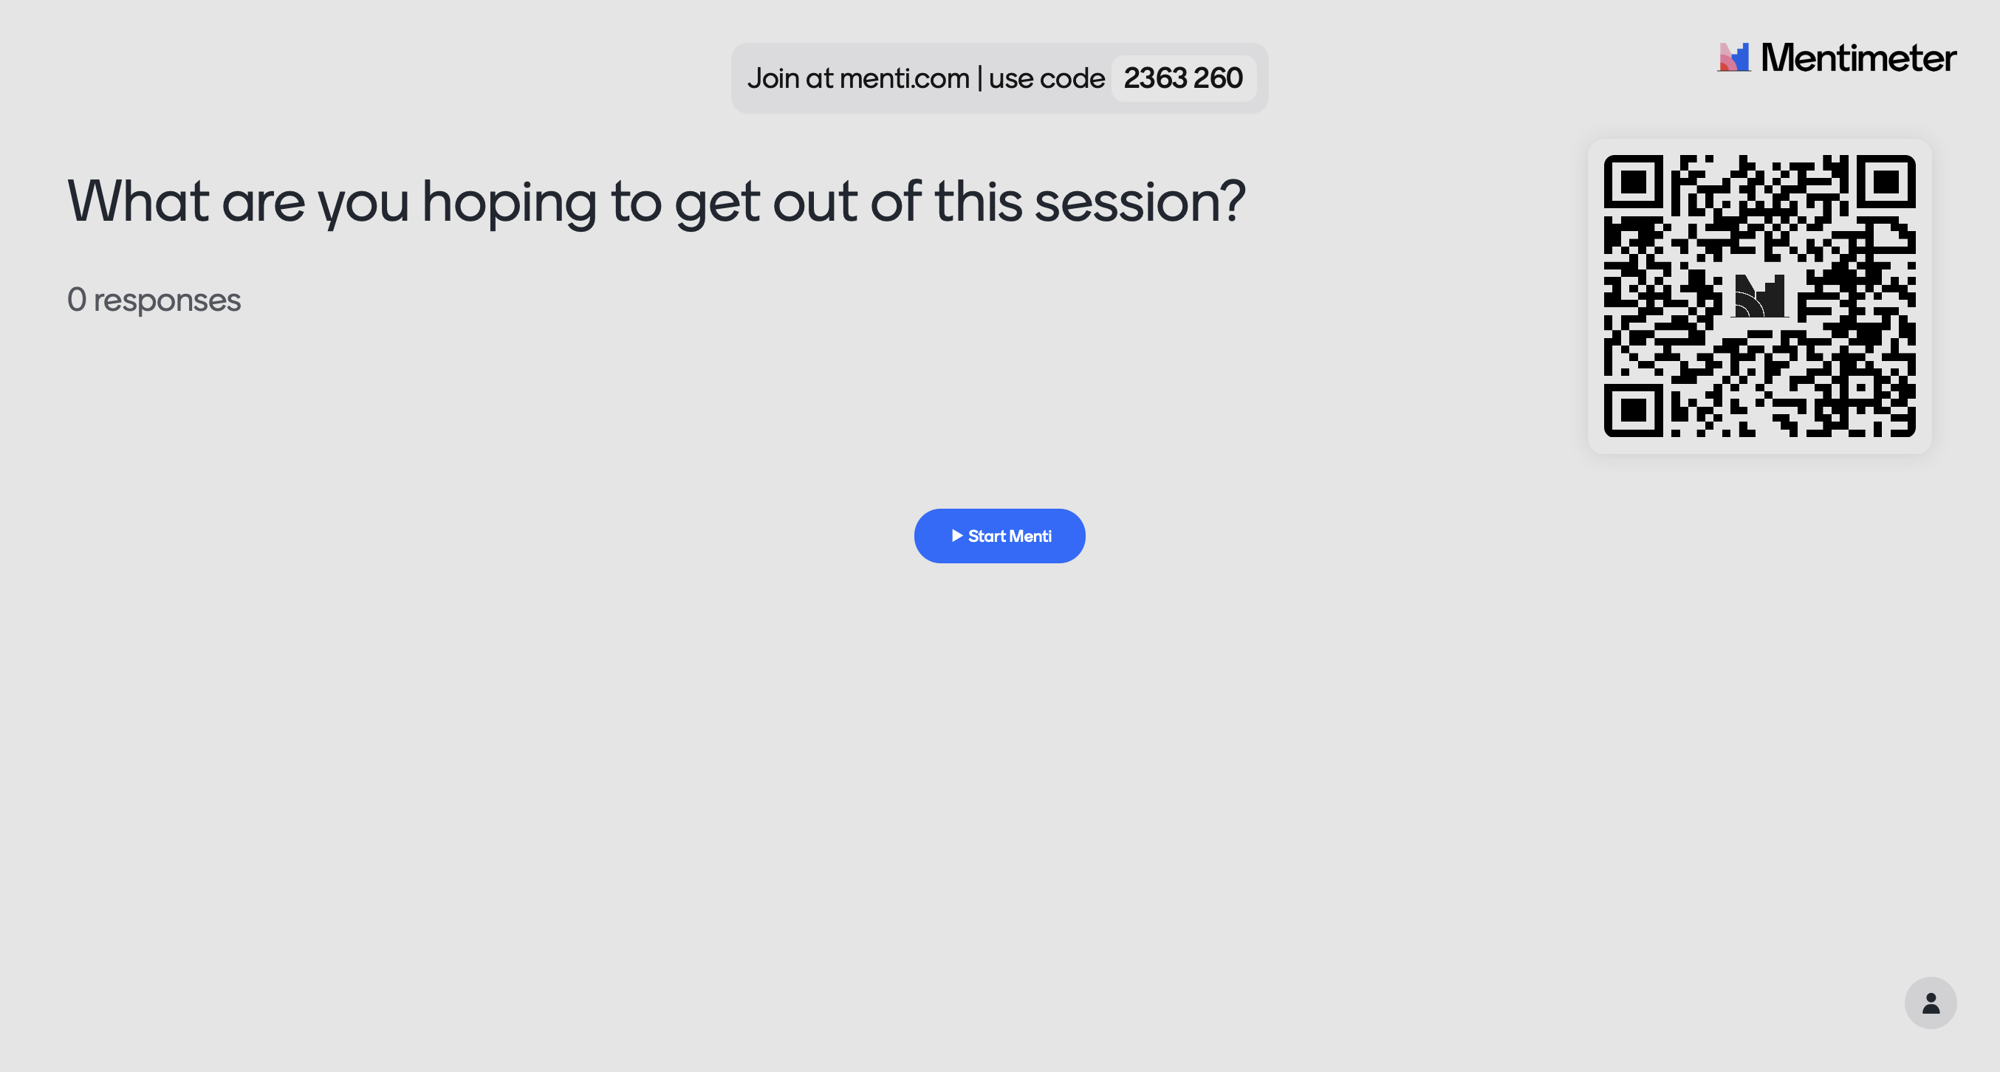

Slide 4


Slide 5
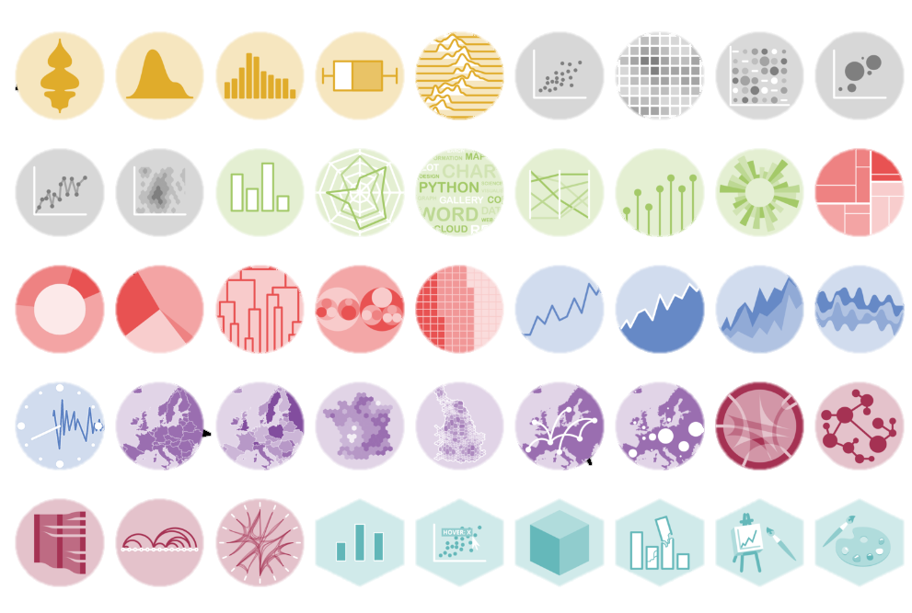
What is Data Visualization?
It is the graphical representation of data or information
https://r-graph-gallery.com

Slide 6
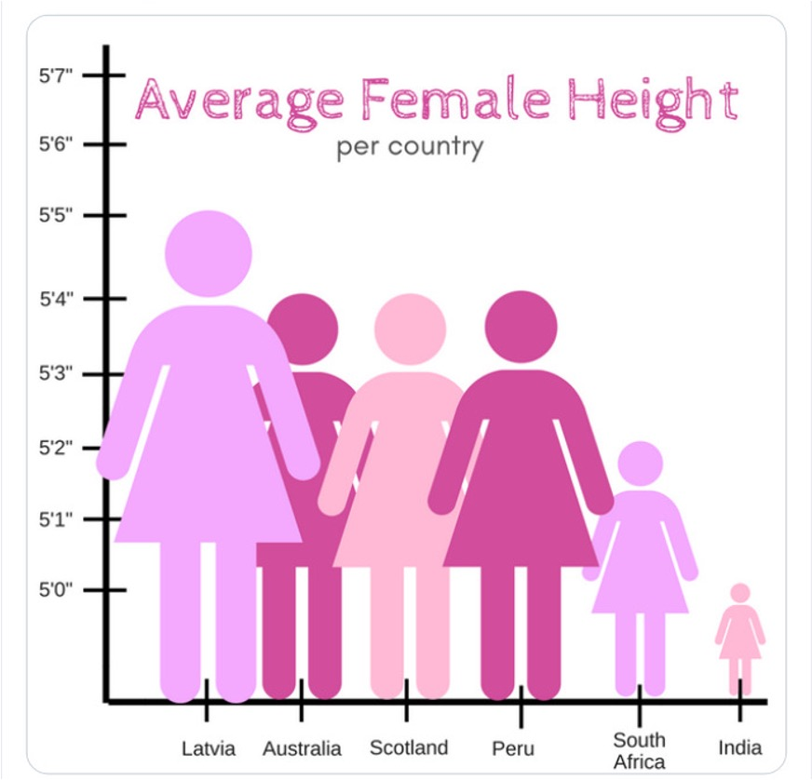

Principles of Good Visualization

Slide 7
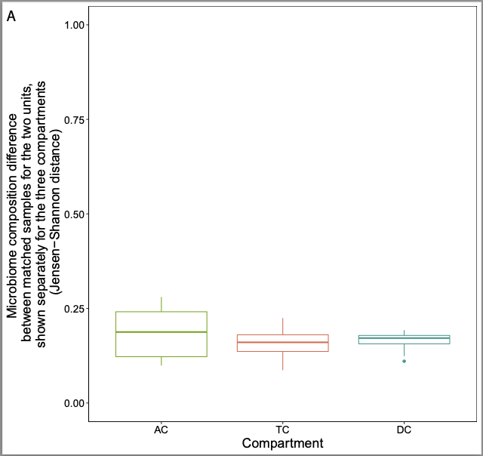
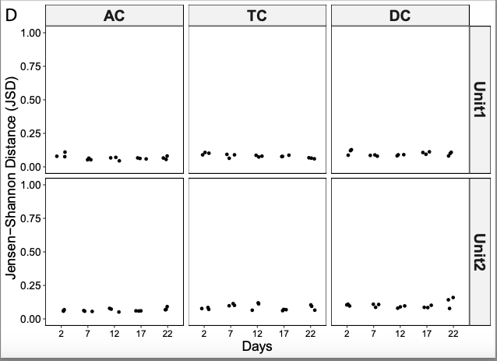
Principles of Good Visualization
What can you say about the first plot?
How about the second one?
What would you make different?

Slide 8
Principle | Description
Show the Data | Clearly present the data without unnecessary elements that distract from understanding.
Avoid Distorting Data | Represent data accurately; avoid misleading scales or transformations.
Enable Comparisons | Make it easy to compare data points, trends, or categories visually.
Show Variability | Highlight uncertainties or variations, such as with error bars or confidence intervals.
Integrate Evidence | Combine text, numbers, and graphics to strengthen the narrative and insights.
Use Visual Hierarchy | Organize elements so the most important information stands out clearly.
Consider the Audience | Tailor visuals to the audience’s level of expertise and interests.
Aesthetic Integrity | Ensure the visualization is attractive but does not compromise accuracy or clarity.
Direct Attention | Use cues like color, labels, or annotations to focus the viewer on key aspects of the visualization.
Keep it Simple | Remove unnecessary elements and focus on the essential aspects of the data.

Slide 9
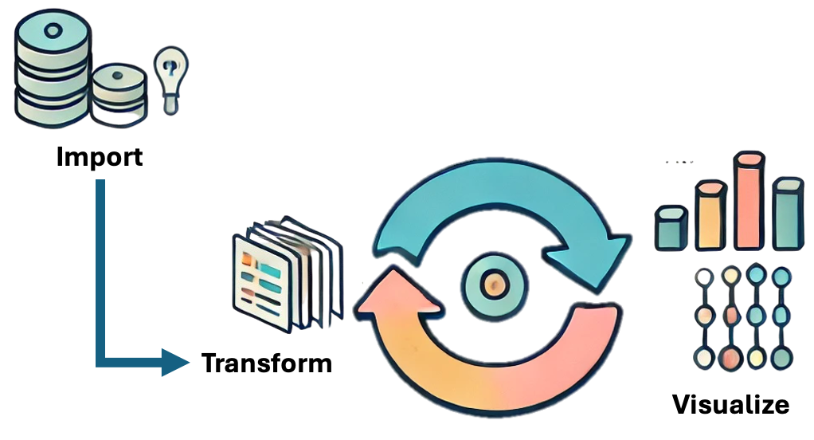
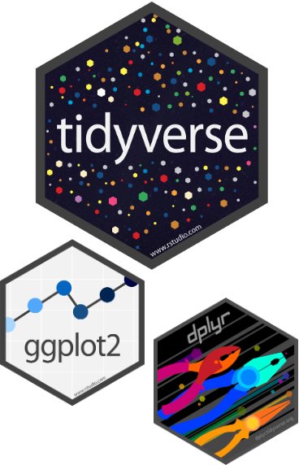
My real life in DataViz
Communicate

Slide 10
Layers
Data: The foundation of your plot.
Aesthetics: Mapping data to visual properties like color, shape, or size.
Geometries: The visual marks (points, lines, bars) used to display data.
Scales: Translating data to visual dimensions.
Facets: Dividing data into subplots for clarity.
Visualizations serve two purposes
Exploration: To discover trends and outliers during data analysis.
Communication: To present findings in a compelling way.
Grammar of Graphics
Hadley Wickham
Notes:
Gemometric object, : the importance of layering in visualizations:
This approach ensures systematic, consistent, and reproducible visuals.

Slide 11
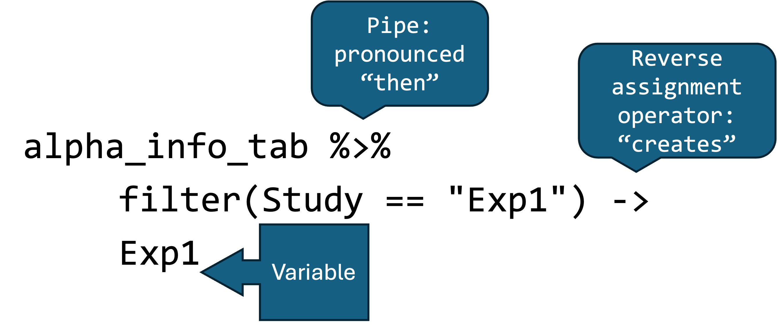
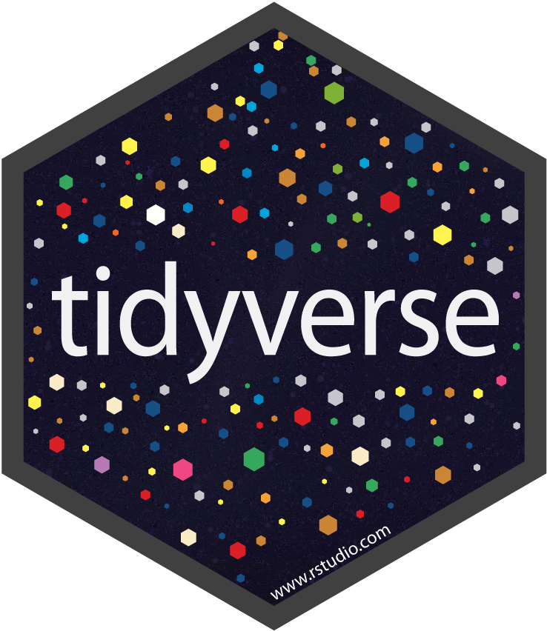
Making Coding Easier
Notes:
alpha_info_tab %>%
filter(Study == "Exp1") ->
Exp1

Slide 12

A good Plot, you cannot do, without first a bad Plot, doing.
"Content inspired by responses from ChatGPT, OpenAI's conversational AI model (accessed November 2024)."

Slide 13
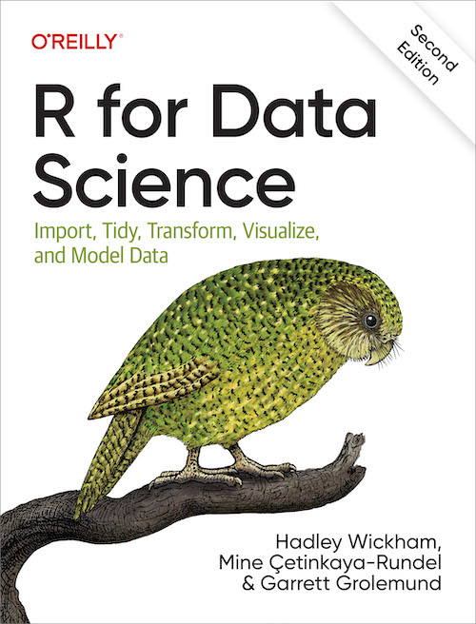
Links for study
R graph Gallery: https://r-graph-gallery.com
Hadley Wickham: https://www.youtube.com/watch?v=9YTNYT1maa4
Books: https://r4ds.hadley.nz/data-visualize

